Slide 1

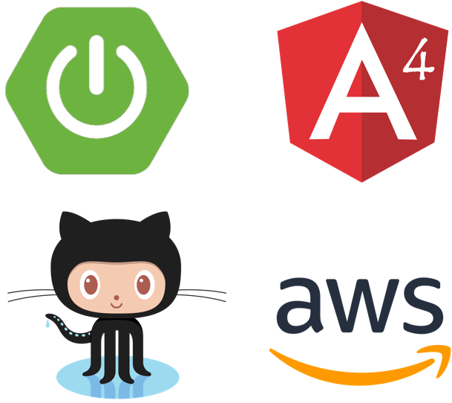

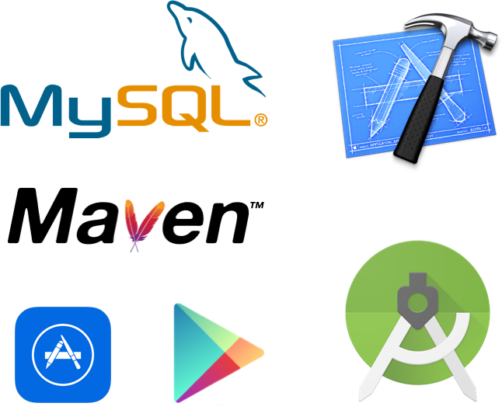
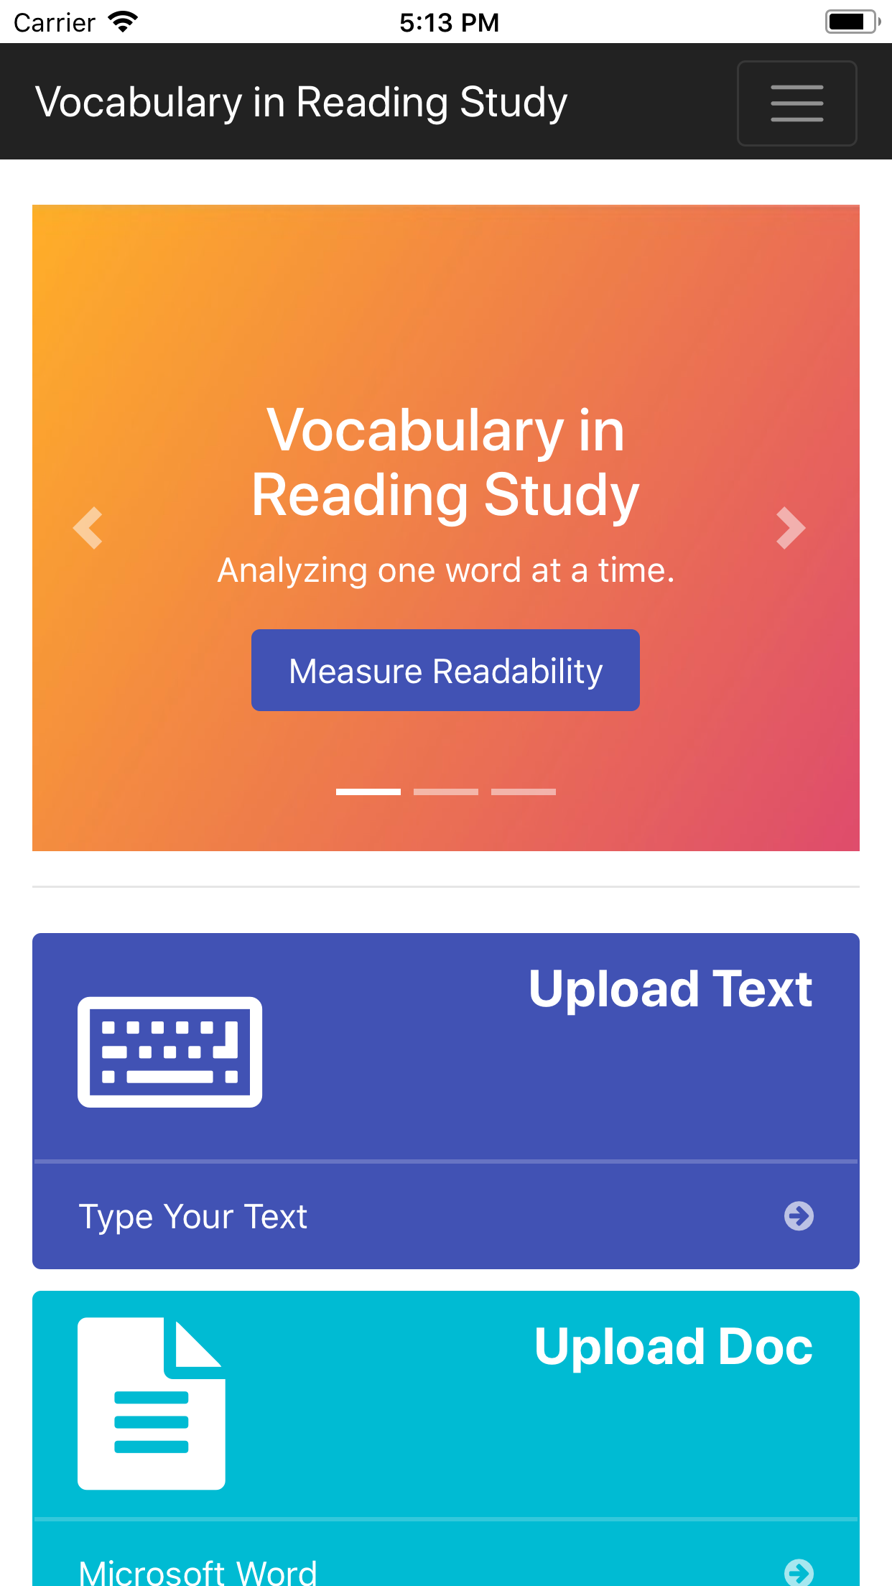
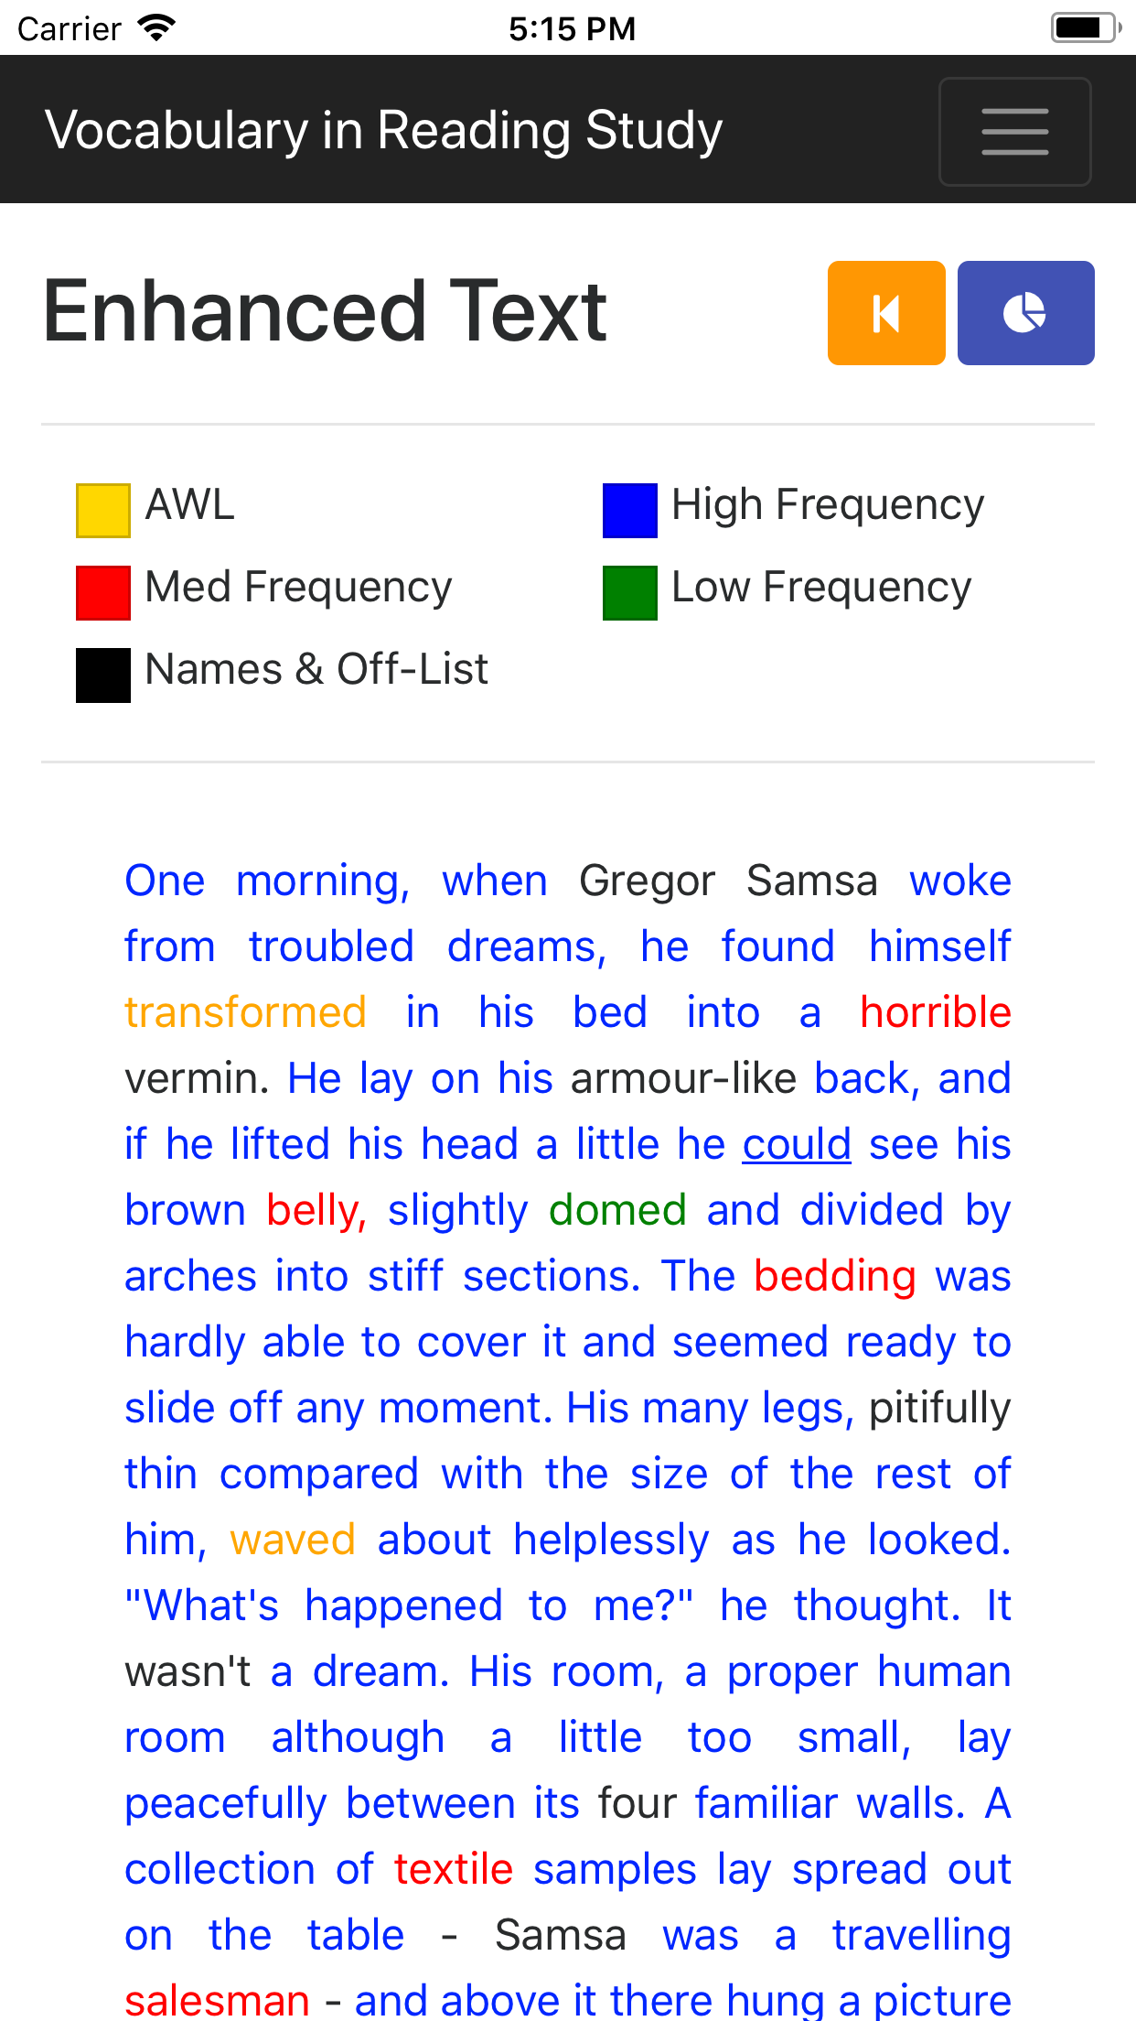
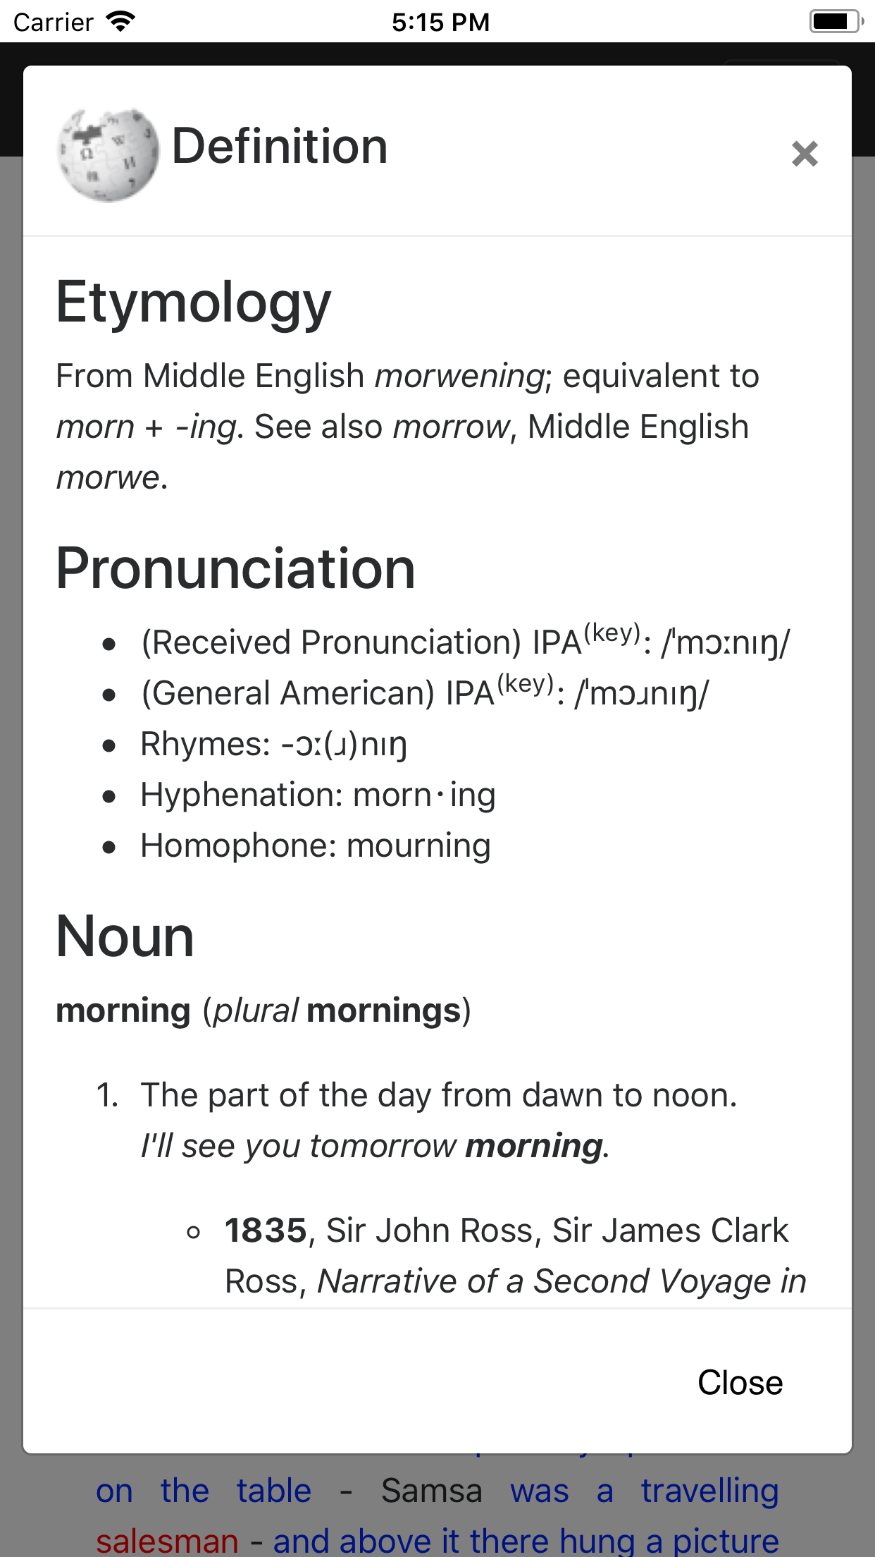
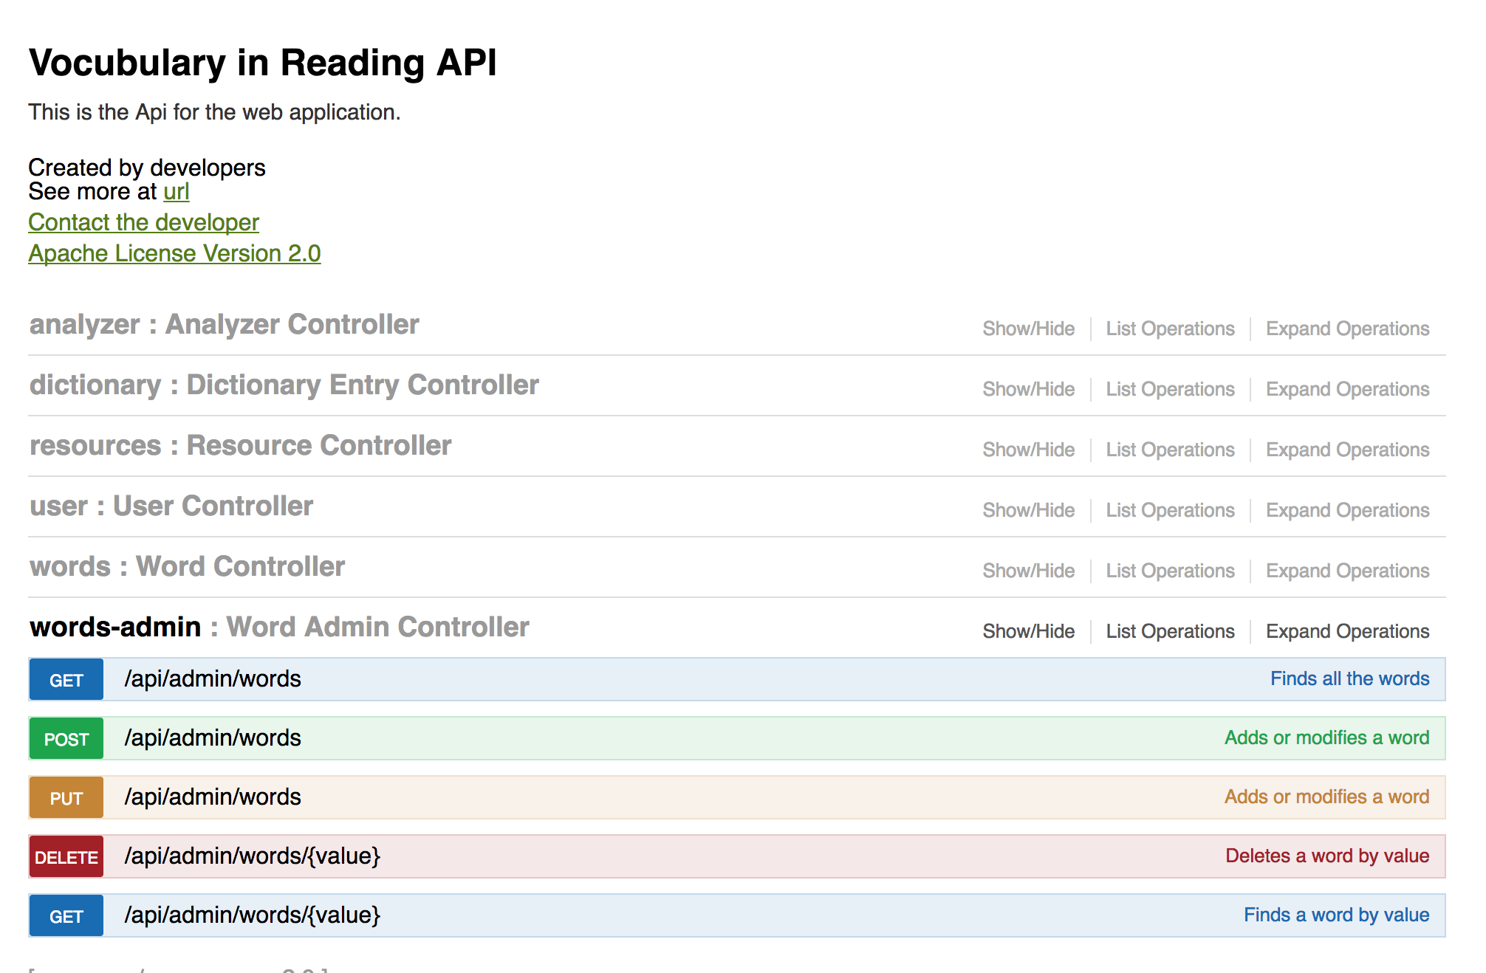
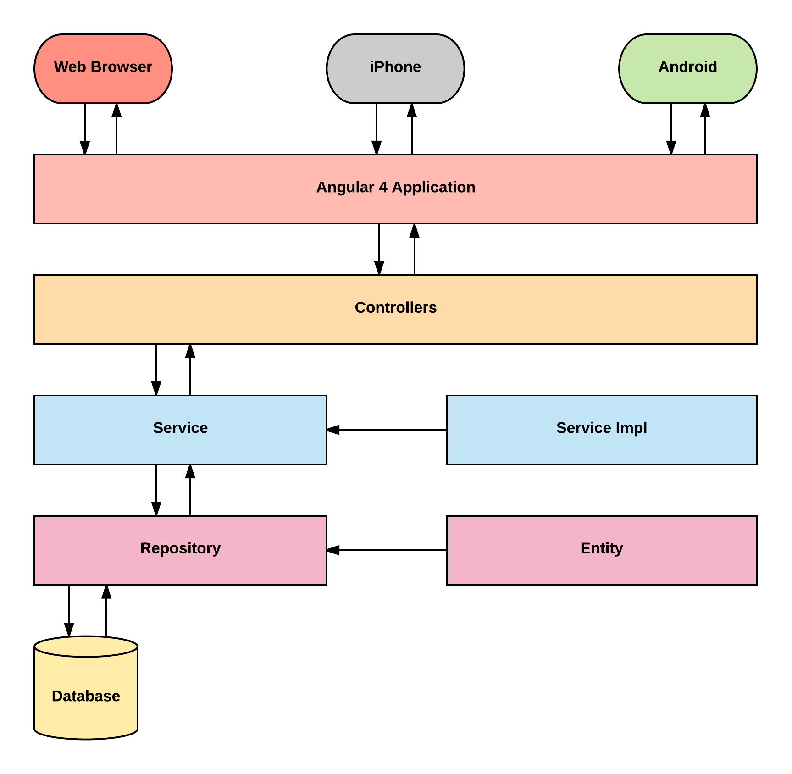
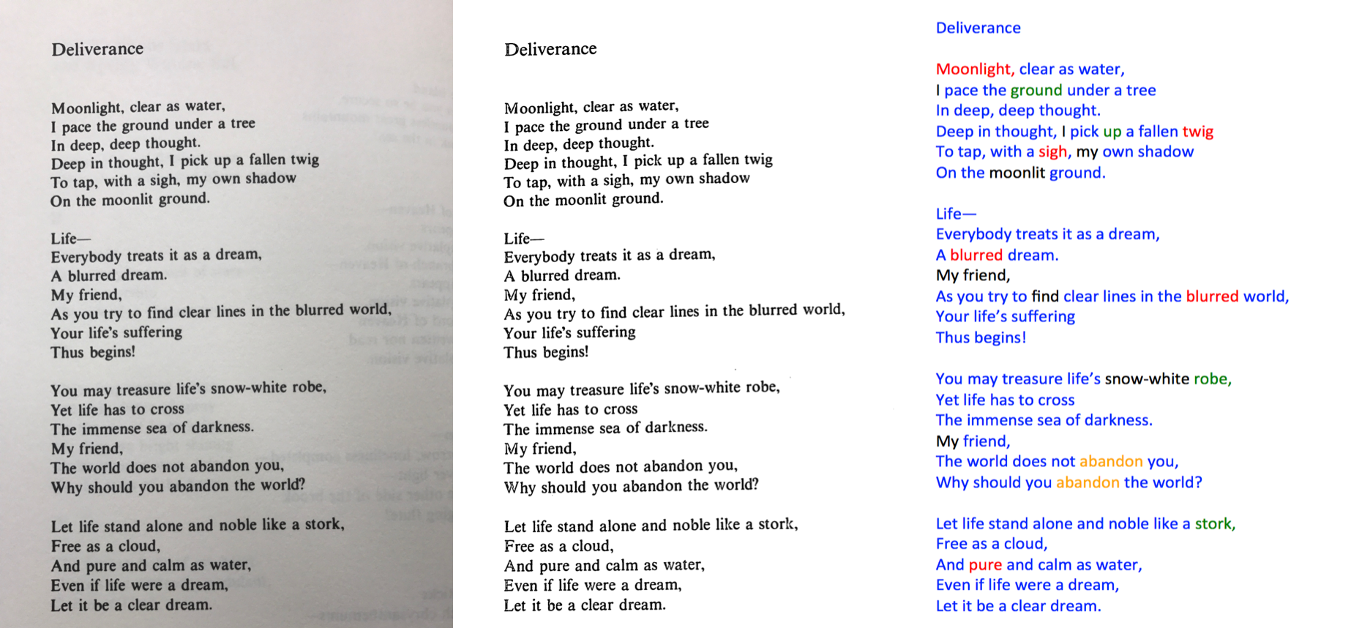
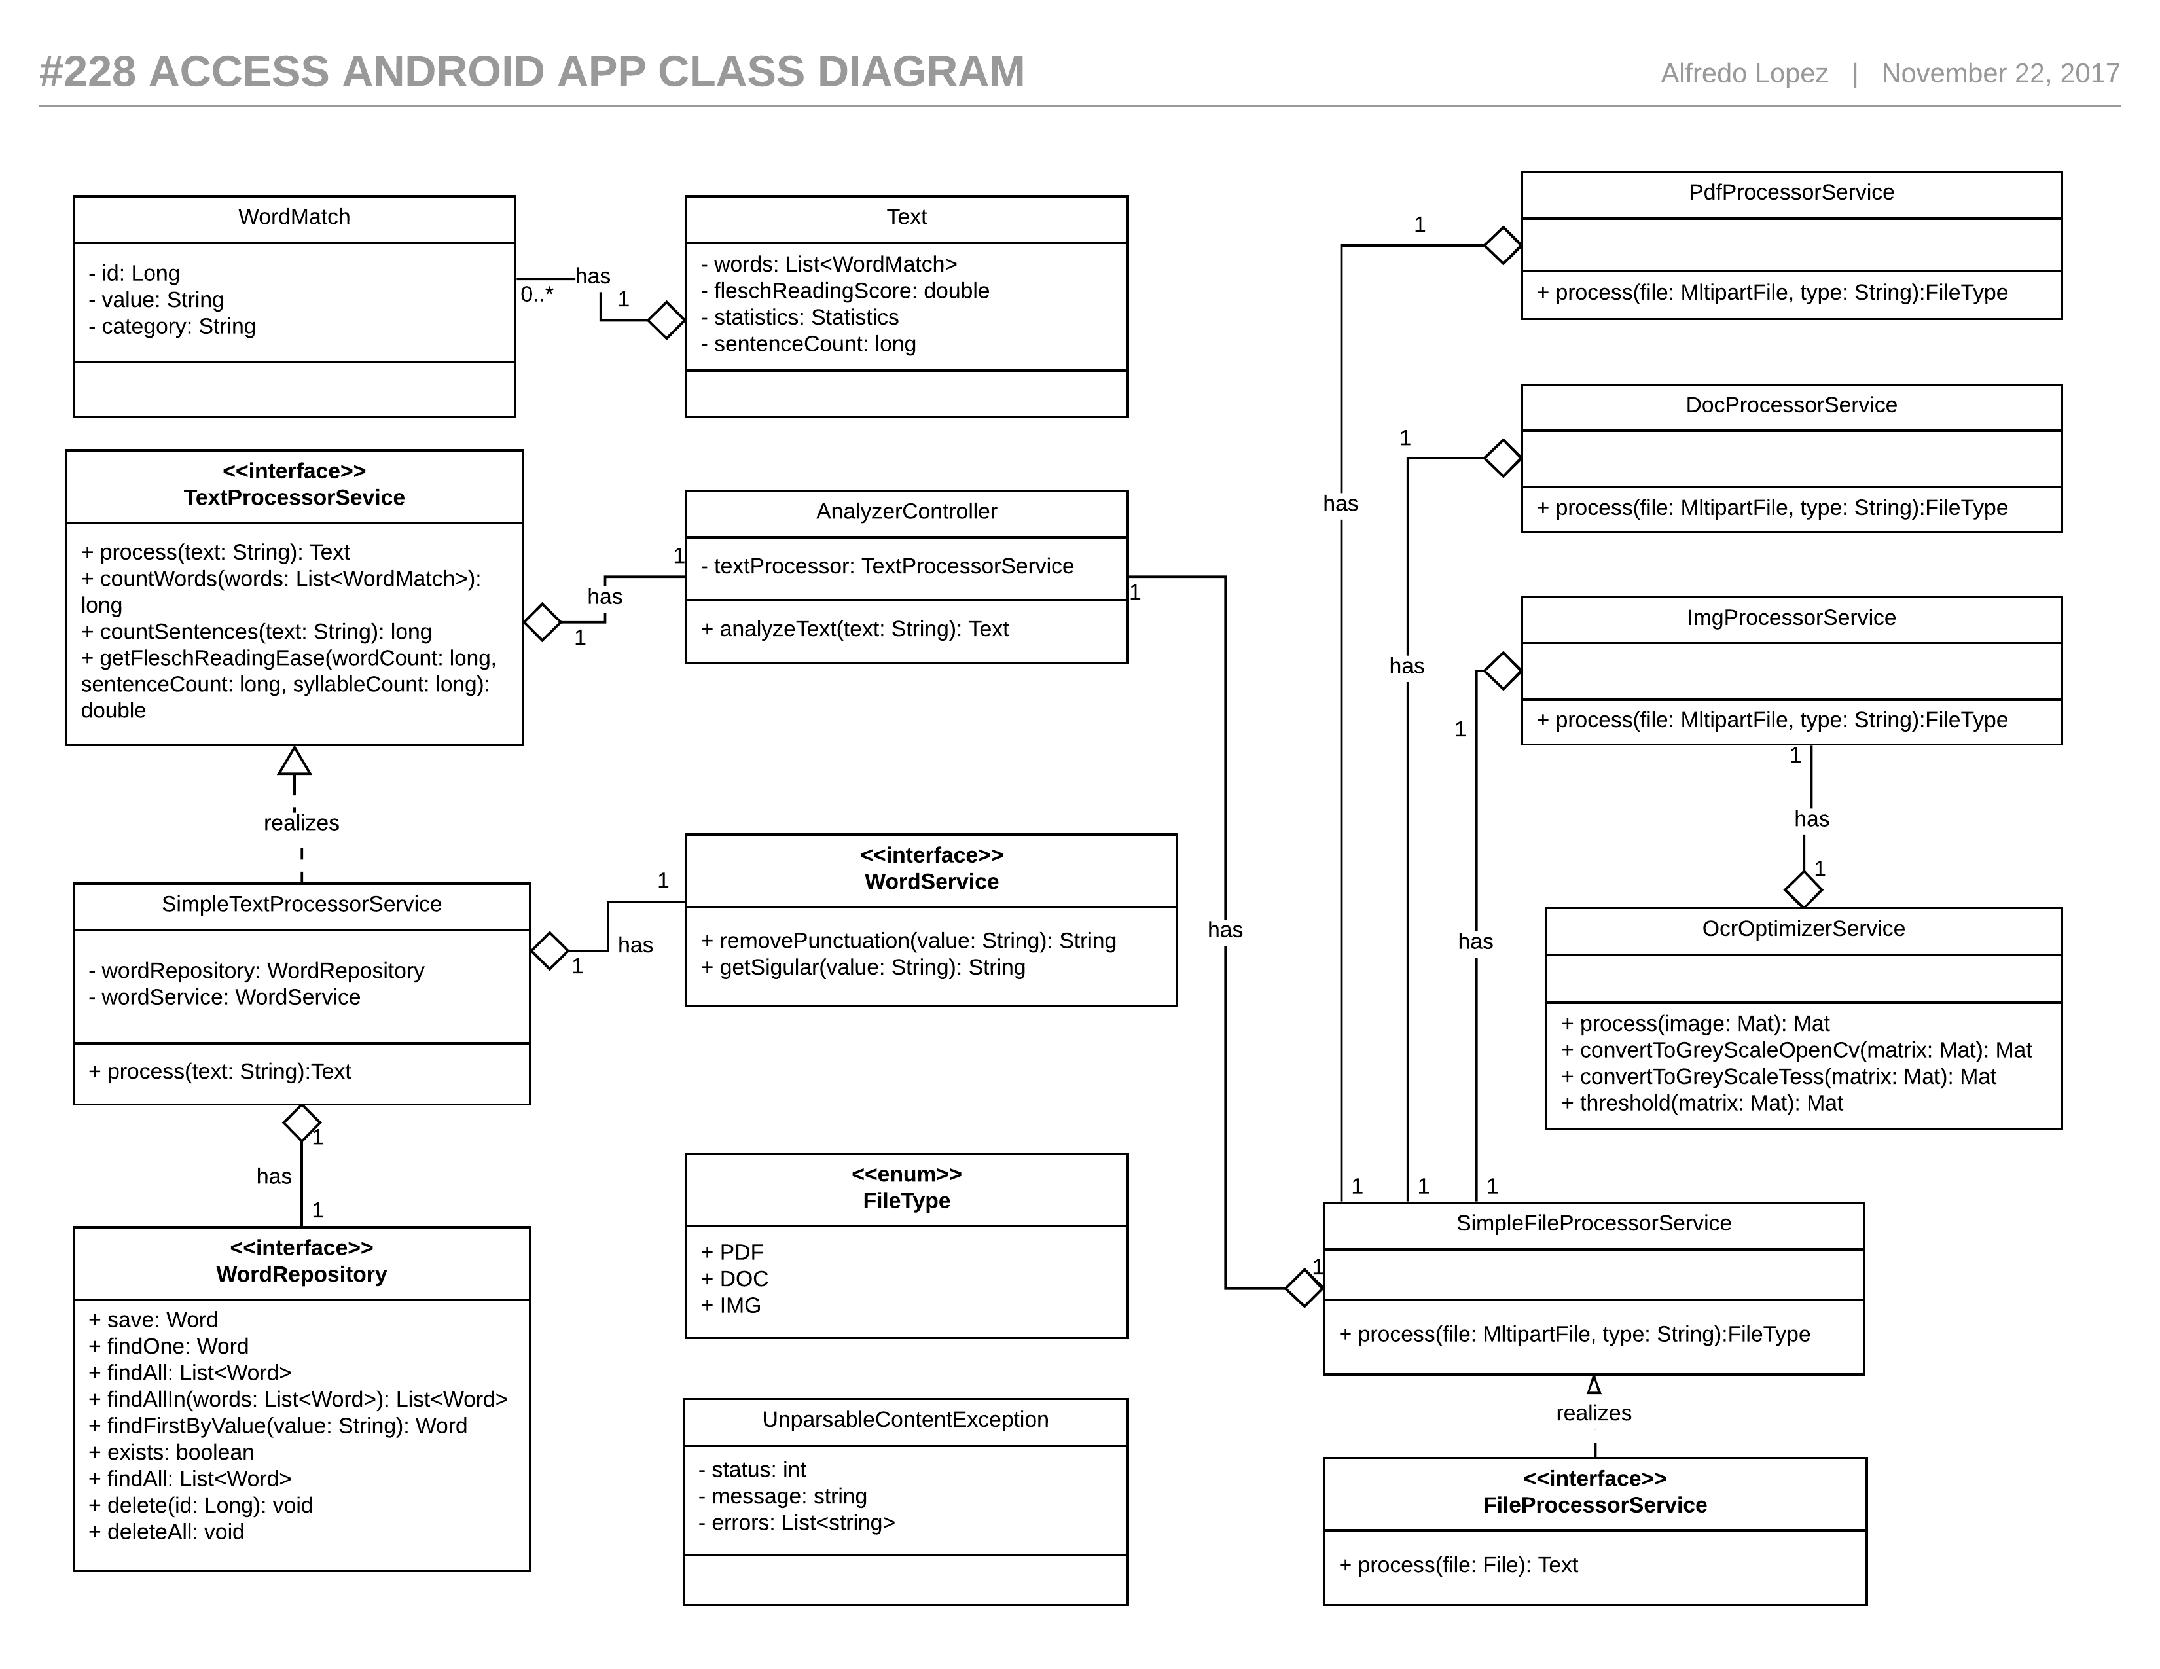
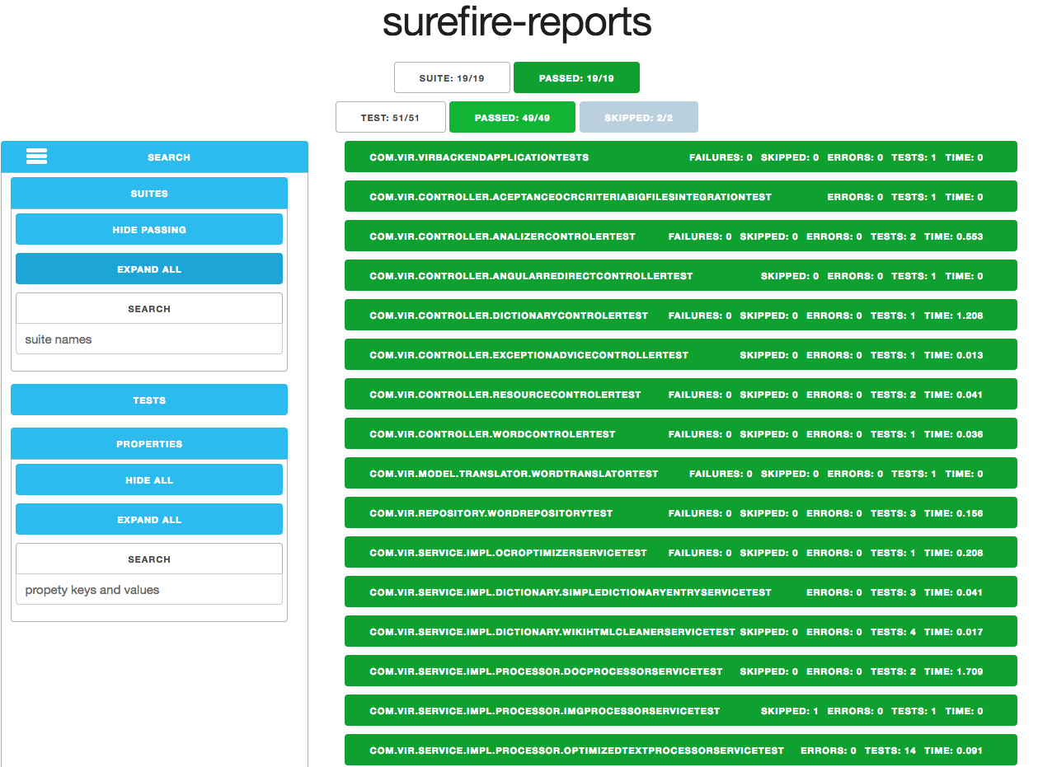
School of Computing & Information Sciences
Senior Project, 2017, Fall
VIRS 2.0
Student: Alfredo Lopez, Florida International University
Mentor: Leila Zahedi, Florida International University
Professor: Masoud Sadjadi, Florida International University
Problem
Professors want to categorize text as per reading difficulty.
When students are reading they would like to know the meaning of the word.
The input comes in different formats making it difficult to process sometimes.
Solution
Create a single web application that analyzes the text.
The result should be displayed in a simple and intuitive way.
The definition for the words will be displayed when clicking.
The application will accept and process text, word docs, pdfs and images.
Current System
VIR-1.0 is the current system and consists of two applications using different technologies.
The word definition always opens a new browser window
No reading score provided.
Only available through the web.
Screenshots
Requirements
Application can analyze text from the four input types.
Character recognition will be performed to pdf and image files.
The Wikipedia definition for the word will be displayed when clicking a word.
The user will be able to see a statistics summary for the text.
Flesch ease readability score will be calculated.
Admins can add and remove words from the lists.
System Design
Model View Controller (MVC) was implemented
Implementation
If the input is image or pdf we perform Optical Character Recognition (OCR)
Using a combination of OpenCV and Tesseract, we manipulate the files to perform OCR recognition.
The text is divided into words and then queried against a MySQL database that contains all information about the word.
Once the information is retrieved, a JSON object with with the original text and the extra metadata is return to the front end.
Metadata not persisted in the database is calculated.
Word definitions are retrieved from Wiki Dictionary.
Verification
Junit was the main tool utilized to verify the system.
Implemented several integration tests that are run before deploying to the web.
Object Design
Acknowledgement
The material presented in this poster is based upon the work supported by my mentor Leila Zahedi and Instructor, Prof. Masoud Sadjadi I am thankful to the help that I received from my group member Milad Ebrahimi.
Notes:
1

